Slide 1
WRESTLING WITH GOD
GENESIS 32:22-32

Slide 2
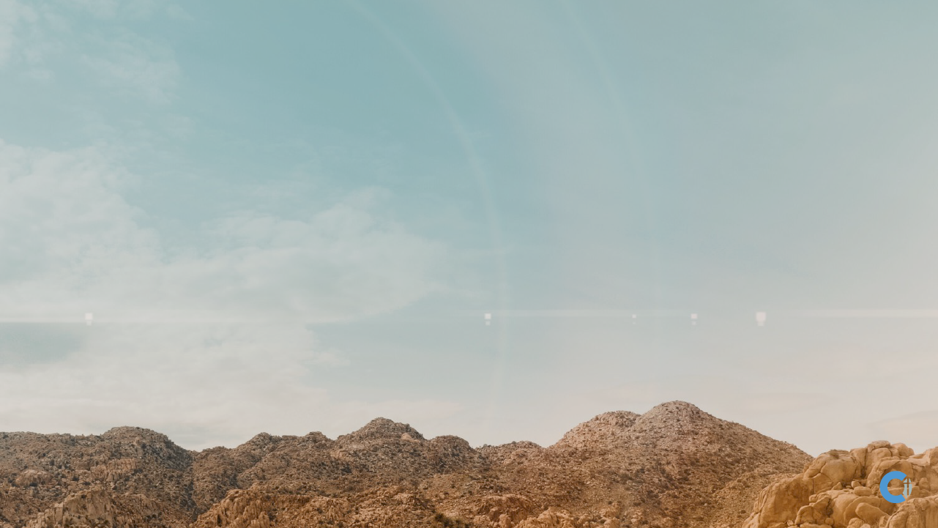

Slide 5
That night Jacob got up and took his two wives, his two female servants and his eleven sons and crossed the ford of the Jabbok.
After he had sent them across the stream, he sent over all his possessions. So
Jacob was left alone, and a man wrestled with him till daybreak.

Slide 6
When the man saw that he could not overpower him, he touched the socket of Jacob’s hip so that his hip was wrenched as he wrestled with the man. Then the man said, “Let me go, for it is daybreak.”
But Jacob replied, “I will not let you go unless you bless me.”

Slide 7
The man asked him, “What is your name?”
“Jacob,” he answered.
Then the man said, “Your name will
no longer be Jacob, but Israel,
because you have struggled with God
and with humans and have overcome.”
Jacob said, “Please tell me your name.”
But he replied, “Why do you ask my name?”
Then he blessed him there.

Slide 8
So Jacob called the place Peniel, saying, “It is because I saw God face to face, and yet my life was spared.”
The sun rose above him as he passed Peniel, and he was limping because of his hip. Therefore to this day the Israelites do not eat the tendon attached to the socket of the hip, because the socket of Jacob’s hip was touched near the tendon.
Genesis 32: 22-32

Slide 9
Jacob is in a difficult place

Slide 10
God initiates a wrestling match
with Jacob

Slide 11
God touches Jacob in a way that causes him to stop fighting

Slide 12
Jacob holds on and asks for a blessing

Slide 13
God requires Jacob to own up
to his name

Slide 14
God gives Jacob a new name that reveals the change in Jacob’s nature

Slide 15
Jacob walked away with a limp

Slide 16
• the wrestling
• the seeking
• the naming
• the blessing
• the limping

Slide 17
So what?
So, what if you are Jacob, and God needs to change your name in order to redeem your present and
rescue your future?

Slide 18
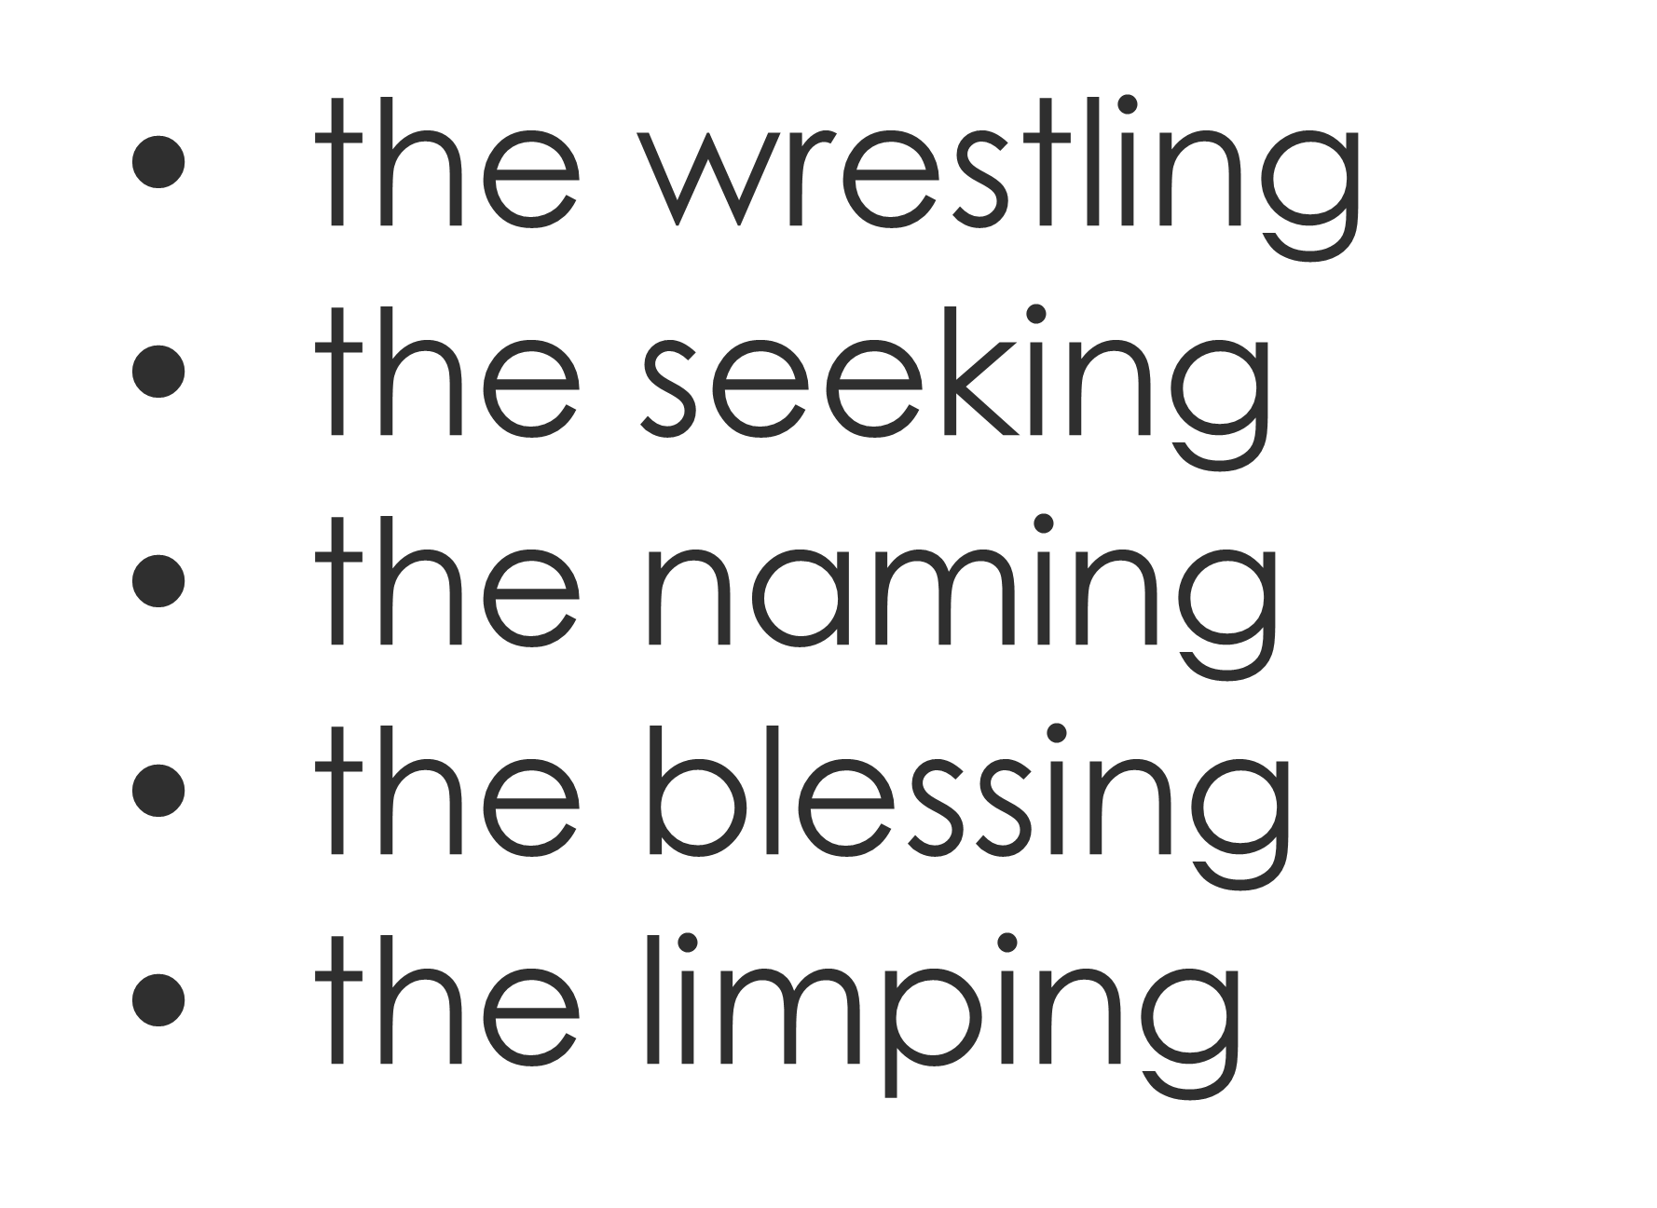
If you want what God alone can give, it will require of you what it required of Jacob:

Slide 19
We can get into difficult places,
like Jacob

Slide 20
God initiates a wrestling match with us

Slide 21
Jacob holds on…but so does God

Slide 22
Like Jacob, God asks us our name

Slide 23
Jacob gets a new name (nature)
and we can, too

Slide 24
WRESTLING WITH GOD
GENESIS 32:22-32

